Slide 1

Technical Weekly Report | EDBD | W08 04/Feb – 17/Feb/2022
Item | Content | Page
Improvement | Study of improvement of the storage performance by improving the corrosion resistance of zinc cans | 2
Development | The new electrolyte prescription | 3
BCP | Improvement of lump of acetylene black from Jiaozuo’s new factory | 4
Deign of materials/ component parts | Gasket shift due to curled zinc can shift (R6 MJ) | 5
Benchmarking | Performance evaluation of Competitor in the Peru Market | 6

Slide 2
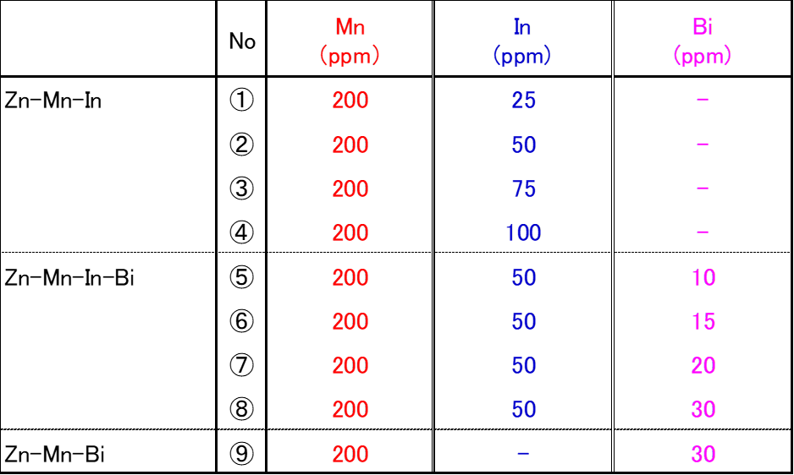
Technical Weekly Report | EDBD | W08 04/Feb – 17/Feb/2022
2
Item/
Study of improvement of the storage performance by improving the corrosion resistance of zinc cans 【Background and Purpose】 ・After changing the lead-no added zinc can, the long-term storage performance at room temperature tend to deteriorate. ・In particular, PECSH batteries using lead-no added zinc materials from other company have been complaining about performance degradation at an early stage. ・In W04, we reported the gas generation test results of lead-no added zinc cans in the low pH electrolyte. It was confirmed that the amount of gas generated from the lead-no added zinc can was larger than that of the lead-added zinc can(old specification), and it tended to be easily corroded at low pH. ・This time, we report the contents of a busbar with a modified alloy composition in order to improve the corrosion resistance of lead-no added zinc cans at low pH. 【Contents】 ・Lead-no added zinc alloy -Zn-Mn-In system （In ; 25 ～100ppm） -Zn-Mn-In-Bi system （In ; 50ppm, Bi ; 10～30ppm） -Zn-Mn-Bi system （Bi ; 30ppm） Mn ; 200ppm ・Mn is master alloy addition, In and Bi direct pure metal addition 【Results】 -The appearance of the busbar was the same as the current one, and there was no problem with castability. -These did not show any cracks or shrinkage cavities after solidification. ⇒, It is necessary to pay attention to the heating temperature before rolling, because Bi added busbar may cause edge cracks during rolling. These will be processed to pellets with PECTH. 【Future plans】 ・Zinc pellets, can making and corrosion resistance evaluation at low pH
Fig1. The sample lists of lead- no added zinc alloy for test

Slide 3
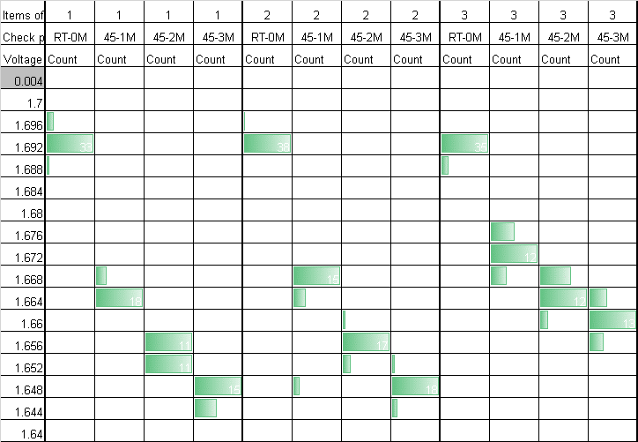
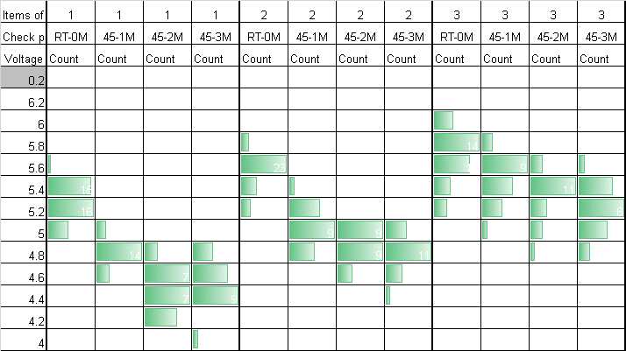
Technical Weekly Report | EDBD | W08 04/Feb – 17/Feb/2022
3
Item/
【Title】 The new electrolyte prescription 【Back ground】 ・Electrolyte prescription for Manganese dry battery in Panasonic has not changed in the past. We use No.130 electrolyte(ZnCl2 : 29.7%, NH4Cl : 1.0%) for a long time. ・ I compare No.130, No. 125 used in Panabras and the best prescription calculated by statistical analysis with pre-evaluation. 【Evaluation】 ・Battery performance Cell type : R6 tube cell in PECIN Cathode : EMD(Zhongxin)/GCA(Denka)=6.0 ZnO additive is 1.5% as EMD weight. Electrolyte : Refer to Table.1 (with 500ppm LC-200) Table.1 Electrolyte prescription 【Results】 Test electrolyte have better performance than No.130. ・OCV and SCC degradation is less. OCV→No.130/-46mV, Test/-31mV SCC→No.130/-0.81A, Test/-0.49A ・Initial discharge performance of 3.9Ω cont. and 3.9Ω LIF are better. ・Duration retention ratio after 45℃3M storage is better (PI retention ratio is No.130:94%, Test:97%) | Fig.1 Static characteristics ●OCV ●SCC Table.2 Static characteristic retention after 45℃3M storage Table.3 Discharge performance (Index : No130 initial performance is 100)
 | OCV(V) |  |  | SCC(A)
 | Initial | 45℃3M | ΔmV | Initial | 45℃3M | ΔA
① | 1.691 | 1.645 | -45.7 | 5.16 | 4.35 | -0.81
② | 1.689 | 1.646 | -44.7 | 5.44 | 4.70 | -0.74
③ | 1.689 | 1.658 | -31.3 | 5.57 | 5.08 | -0.49
 | Electrolyte | ZnCl2 | NH4Cl | H2O
① | No.130 | 29.70 | 1.00 | 69.3
② | No.125 | 25.60 | 2.54 | 71.86
③ | Test | 22.80 | 4.56 | 72.64
 | Resistance(Ω) | 3.9 | 3.9 | 3.9 | 100mA | 50mA | 43 | PI
 | mode | Cont.M | LIF | 1H/D | 1H/D | 1H/8H,24H/D | 4H/D
 | End point(V) | 0.9 | 0.9 | 0.8 | 0.9 | 1.0 | 0.9
 | unit | min | min | hour | hour | hour | hour
① | Initial | 100 | 100 | 100 | 100 | 100 | 100 | 100
 | 45℃3M | 92 | 91 | 97 | 94 | 94 | 95 | 94
 | Retention ratio/% | 92 | 91 | 97 | 94 | 94 | 95 | 94
② | Initial | 109 | 107 | 101 | 100 | 100 | 100 | 103
 | 45℃3M | 91 | 95 | 97 | 95 | 94 | 95 | 94
 | Retention ratio/% | 84 | 89 | 96 | 95 | 95 | 95 | 91
③ | Initial | 109 | 104 | 100 | 99 | 97 | 100 | 102
 | 45℃3M | 102 | 101 | 99 | 96 | 95 | 96 | 98
 | Retention ratio/% | 93 | 98 | 99 | 97 | 98 | 96 | 97

Slide 4
Technical Weekly Report | EDBD | W08 04/Feb – 17/Feb/2022
4
Item/
Improvement of lump of acetylene black from Jiaozuo [Back ground & Objective] Lump of acetylene black in Jiaozuo’s product caused nozzle clogging of RME machine in PECGI. As a result of negotiation with Jiaozuo, they introduced new equipment to remove the lump and sent the sample to us. In previous report, we reported initial evaluation result. This time, we will report the result after 45℃-1M storage. [Sample]1)Acetylene black after improvement . 2)Acetylene black before improvement. [Evaluation] Discharge , analysis [Result] We evaluated each acetylene black in EDBD Lab. (R6 tube type battery)Mix condition was EMD 100%, M/C=6, EMD; South manganese, AB;(above), Electrolyte ; No.130 with LTC-35A. Table 1 shows static characteristics until 1M storage. The battery with acetylene black after improvement showed almost same OCV, SCC and IR value with that before improvement. Table 2 shows initial discharge result. Initial discharge performance of the sample after countermeasure were similar level in all modes. Table 3 the performance after 1M storage. The discharge performance of the sample after countermeasure were also similar level in all modes. Based on above results, we judged that the improved sample was no problem on performance and almost same with that before improvement. [Further investigation] - Evaluation after 3M storage.
Table 1 Static characteristics
Table 2 Initial discharge performance
Table 3 discharge performance after 45℃-1M storage

Slide 5
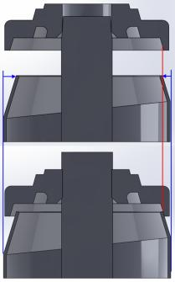
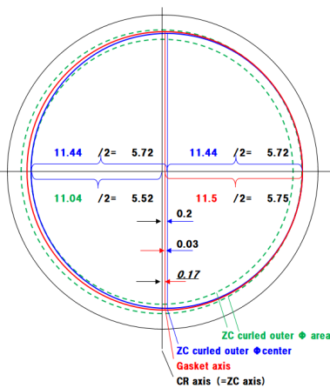
Technical Weekly Report | EDBD | W08 04/Feb – 17/Feb/2022
5
Item/.
Gasket shift due to curled zinc can shift (R6 MJ) [Back ground ＆ Objective] Evertack E-975TW leakage has been occurred. Separated polybutene leaked between carbon rod and gasket. The gap is observed with CT photo. This may be caused by following as shown in right figure. If the curled zinc can is shifted to right, zinc can top interferes with gasket in inserting gasket. The gasket is shifted after insertion. [Evaluation] We evaluated the gasket axis shift from design spec of zinc can, carbon rod and gasket. [Result] ZC curled outer Φ(blue circle) has to be within green dotted area (Φ11.44±0.4). The blue circle shows largest shifted ZC curled outer Φ. After gasket insertion, gasket bottom inner Φ(red circle)is tangent to ZC curled outer Φ on the orange square point. 0.2mm is distance between CR axis and ZC curled outer Φ center. (=11.44/2-11.04/2). 0.03mm is distance between gasket axis and ZC curled outer Φ axis(=11.5/2-11.44/2). Therefore 0.17mm is distance between gasket axis and CR axis(=ZC axis)(=0.2-0.03). [Consideration] If CR axis is located on ZC axis and ZC curled outer Φ shift is largest, gasket axis is shifted by 0.17mm from CR axis. This may causes gap on the right contact surface of CR and gasket. (Press fit 0.15mm＜ Gasket axis shift 0.17mm) [Future activity] In actual battery production, carbon rod tilt occurs by apx. max.1.5°in inserting carbon rod. We will simulate and observe the gap in inserting gasket.
If the curled zinc can is shifted to right,
zinc can top interferes with gasket in inserting gasket.
The gasket is shifted after insertion.
Press fit
0.15
Φ3.85
Gasket inner
Φ4
CR
Zinc can | side t | 0.22 | +0.03/ | -0.02 | 0.22
 | Curled inner Φ | 11 | ± | 0.4 | 11
 | (Curled outer Φ) | (11.44 | ± | 0.4) | 11.44
 | Cured outer Φ shift |  |  |  | 0.2
Carbon rod | Φ | 4 | ± | 0.03 | 4
 | axis shift |  |  |  | 0
Gasket | hole height(Current) | 2.2 | ± | 0.1 | 2.2
 | bottom inner Φ | 11.5 | ± | 0.1 | 11.5
 | axis shift (right from CR axis:+) |  |  |  | 0.17
 | inner Φ | 3.85 | ± | 0.1 | 3.85

Slide 6
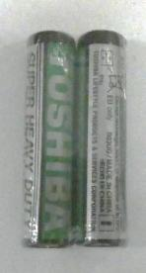
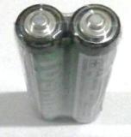
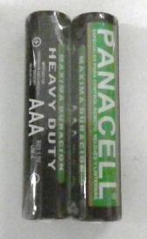
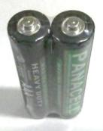
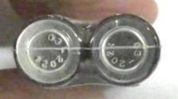
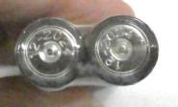
Technical Weekly Report | EDBD | W08 04/Feb – 17/Feb/2022
6
Item/
【Background】 Continue to W04 In order to expand sales in the Latin American market, we conducted research on the trends of other companies and evaluated the performance of other companies' batteries. 【Purpose】 Performance evaluation of other companies in the Peru Market 【Item】 R03:Toshiba/China, Panacell/China Test : Discharge performance (Initial, 45-3M) Heavy metal content 【Result】 When the Toshiba battery is stored at 45 C for 3 months and then subjected to a discharge test, there is the probability of abnormal discharge in 5.1ohm continue. Even if at initial, it is abnormal discharge performance by digital audio mode. The Panacell battery can be used without Any problems. Panacell are environmentally products because Pb is not added. See the next chart.

